Slide 1


Hello
Everyone !!

Slide 2

Are you curious to know about IOE?

Slide 3

Are you nervous because of your Little-knowledge about IOE?

Slide 4

Are you stressed out because of your cluelessness about IOE?

Slide 5


Don’t
Worry !!
We are here to answer your all queries

Slide 6

if you are an engineering aspirant
here we provide
the detailed procedure
from entrance preparation
to admission

Slide 7


What
is
IOE??
Tribhuban University
INSTITUTE OF ENGINEERING

Slide 8
IOE
The Tribhuvan University (TU) - affiliated institute relating to the engineering field known as the Institute of Engineering (IOE) is thought to be responsible for primarily supervising engineering college in Nepal.
Established in
1930 - Technical Training School,
1972- Institute of Engineering.

Slide 9
More than 50 Colleges with different University Affiliation
Tribhuvan University (T.U)
Kathmandu University (K.U)
Purwanchal University (P.U)
Pokhara University (Po.U)

Slide 10
15 - TU-affiliated engineering colleges in Nepal.
5 - are the constituent institution ( top priority of students)
Pulchowk Engineering Campus,Lalitpur
Thapathali Campus,Kathmandu
Western region Campus , Pokhara
Eastern Region Campus , Dharan
Chitwan Engineering Campus,Rampur

Slide 11
Where the entrance examination is held?

Slide 12

The IOE entrance is held in the Central Campus i.e. Pulchowk Engineering Campus. This examination is computer-based so, it is taken in the ICTC building of Central Campus.

Slide 13
How can you crack IOE Entrance??

Slide 14
10 PRACTICAL TIPS TO SUCCEED IN THE EXAM:
1. Set Clear Goals
2. Create a Study Plan
3. Focus on Understanding Concepts
4. Practice Regularly
5. Strengthen Weak Areas
6. Enhance Your English Skills
7. Stay Healthy
8. Stay Positive and Motivated
9. Use Quality Study Resources
10. Time Management in Exams

Slide 15
IOE ENTRANCE is a difficult step where you need to stay aware and careful. It is a tough examination where around 10-15 thousands students compete to study in IOE institute each year. But, less than half of the students are able to qualify for studying at TU affiliated IOE college.

Slide 16
SYLLABUS
This exam requires you to excel in four crucial subjects: Physics, Math, Chemistry, and English.
Long Questions carry 2 marks
the short ones carry 1 marks each.
Mathematics 50 marks
Physics 40 marks
Chemistry 30 marks
English 20 marks
TOTAL = 140marks
TIME = 2 hours

Slide 17
NEGATIVE MARKING
Subsequently,once we click an answer,it is mandatory to choose an option.If you make 10 mistakes,then additional 1 mark will be deducted from your total marks.

Slide 18
FEE Structure?

Slide 19
Per Semester FEE
Regular - 5,890/-
Paying - 43,600/-
Recent Government College Fee
Regular – 56,700/-
Paying - 4,90,000/-

Slide 20
How many seats does IOE offer in total to students?

Slide 21
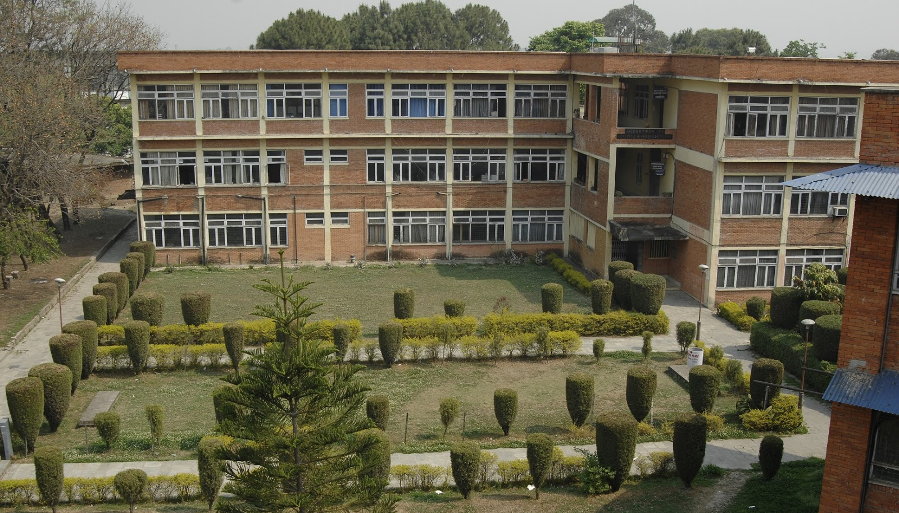
Pulchowk Engineering Campus,Lalitpur

Slide 22
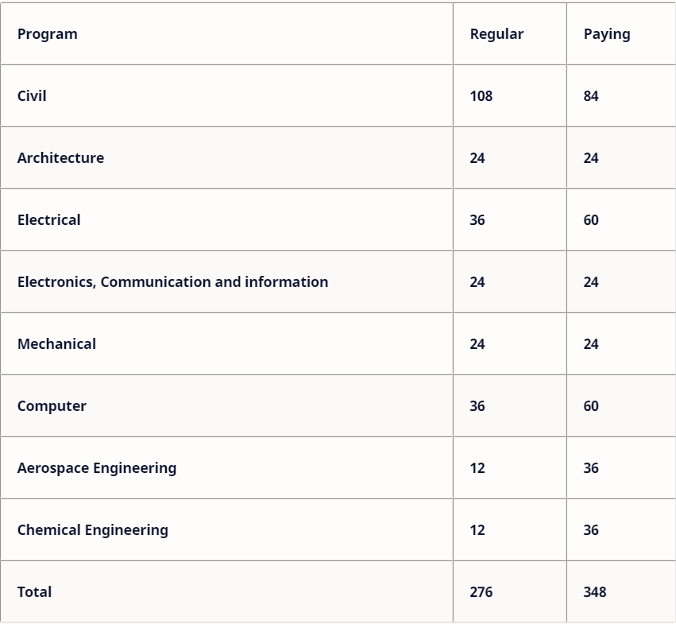

Slide 23
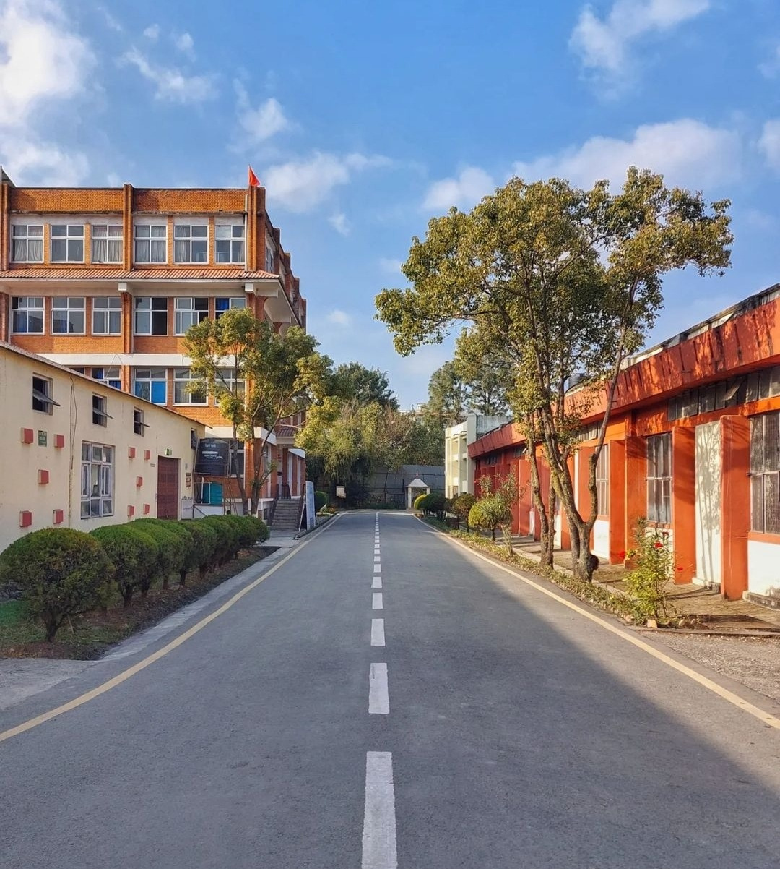
Thapathali Campus,Kathmandu

Slide 24
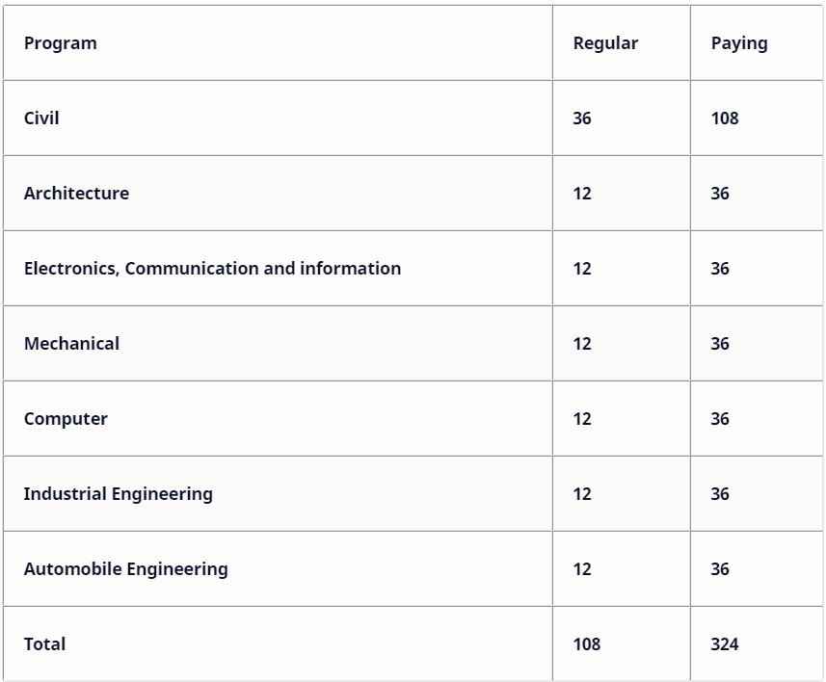

Slide 25
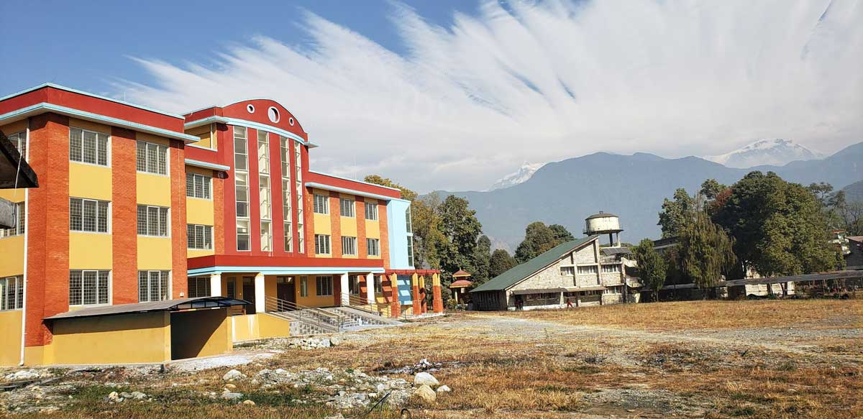
Western region Campus , Pokhara

Slide 26
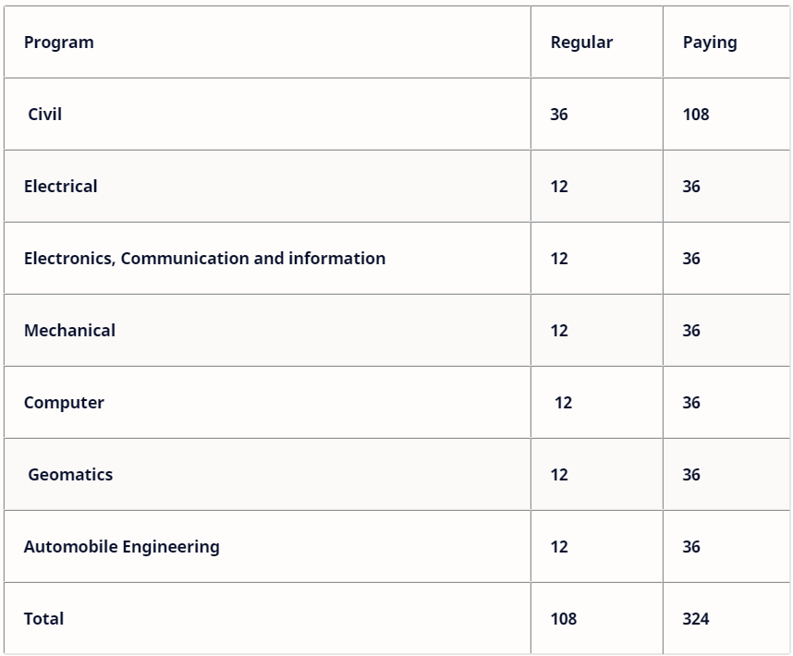

Slide 27
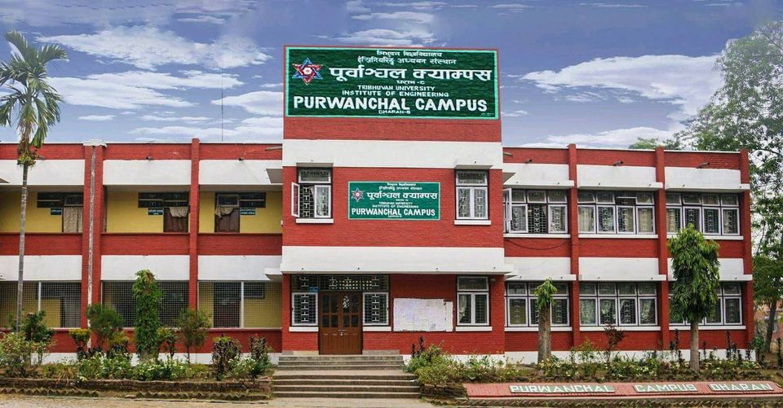
Eastern Region Campus , Dharan

Slide 28
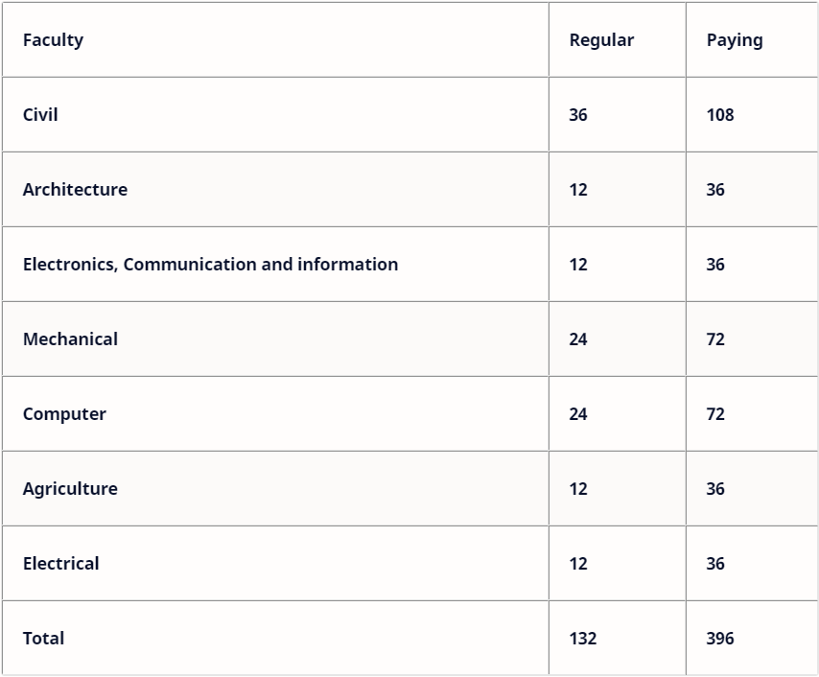

Slide 29
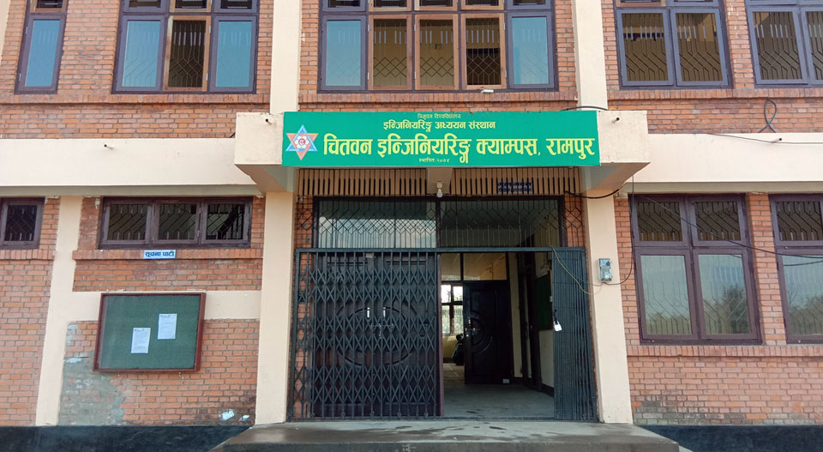
Chitwan Engineering Campus,Rampur

Slide 30
Faculty | Regular | Paying
Architecture | 6 | 18
Total | 6 | 18

Slide 31




10 Affiliated engineering colleges of IOE

Slide 32

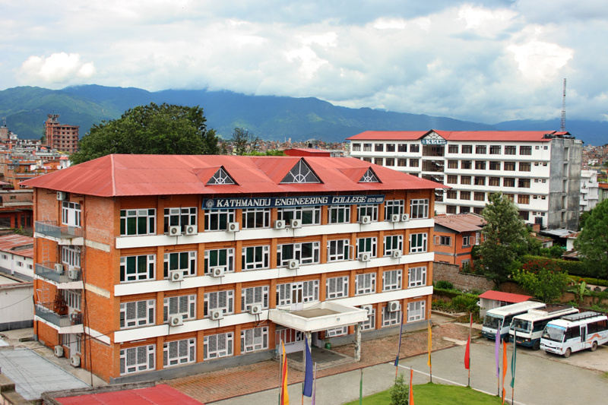
1.KATHMANDU ENGINEERING COLLEGE

Slide 33

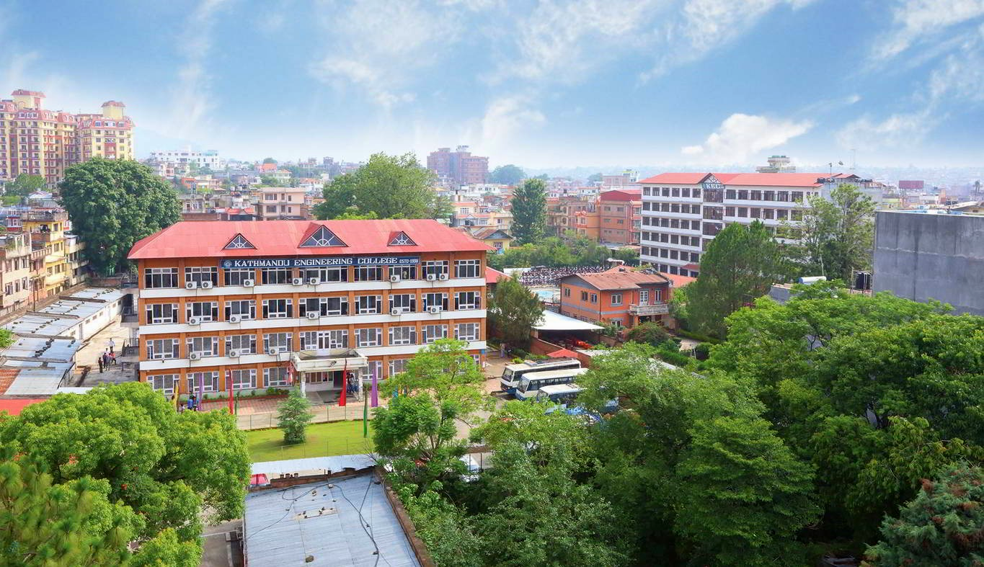

PROGRAMS OFFERED & NUMBER OF SEATS

Slide 34





Bachelor
in Architecture
(48)
BE in
Civil Engineering
(96)
BE in
Computer Engineering (96)

Slide 35


BE in
Electronics, Communication & Information Engineering
(96)
BE in
Electrical Engineering (48)

Slide 36
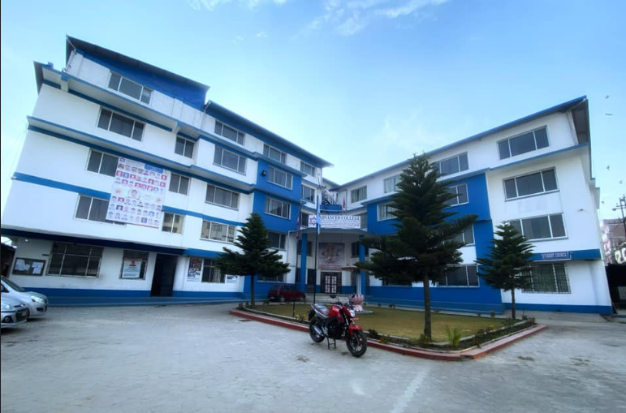
2.ADVANCED COLLEGE OF ENGINEERING AND MANAGEMENT

Slide 37
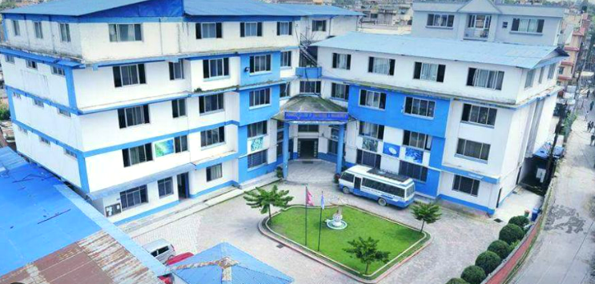
PROGRAMS OFFERED & NUMBER OF SEATS

Slide 38


BE in
Civil Engineering
(96)
BE in
Computer Engineering (96)

Slide 39


BE in
Electronics, Communication & Information Engineering
(96)
BE in
Electrical Engineering (48)

Slide 40
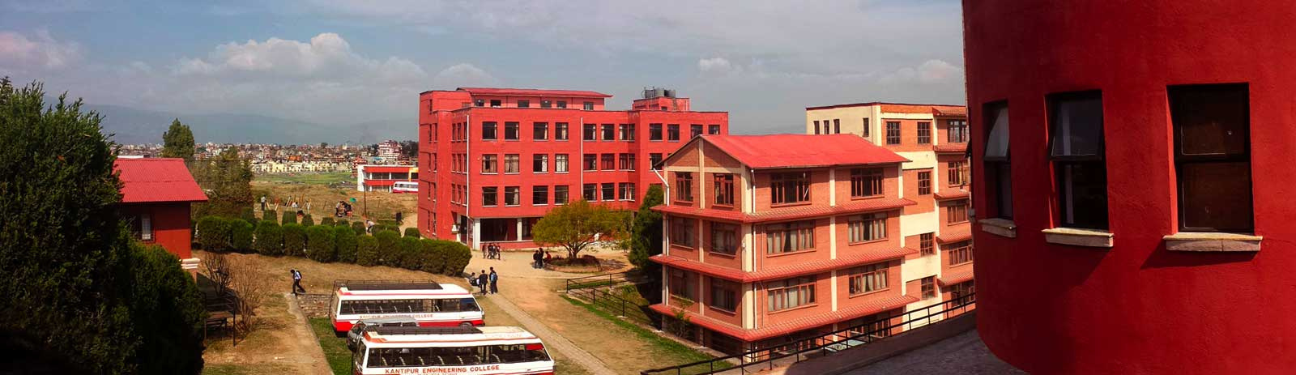
3.KANTIPUR ENGINEERING COLLEGE

Slide 41
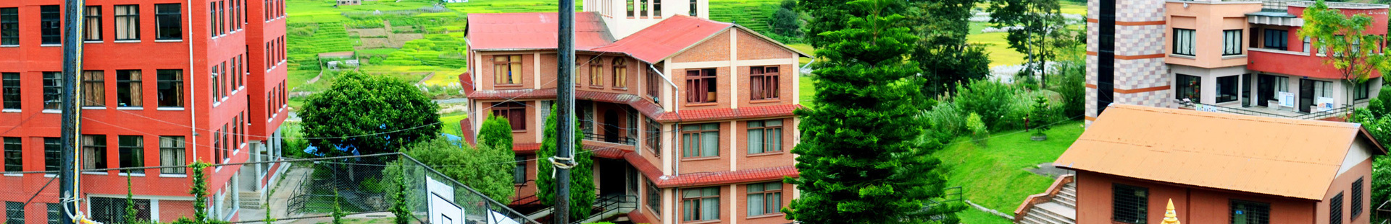
PROGRAMS OFFERED & NUMBER OF SEATS

Slide 42



BE in
Electronics, Communication & Information Engineering
(96)
BE in
Civil Engineering
(96)
BE in
Computer Engineering (96)

Slide 43
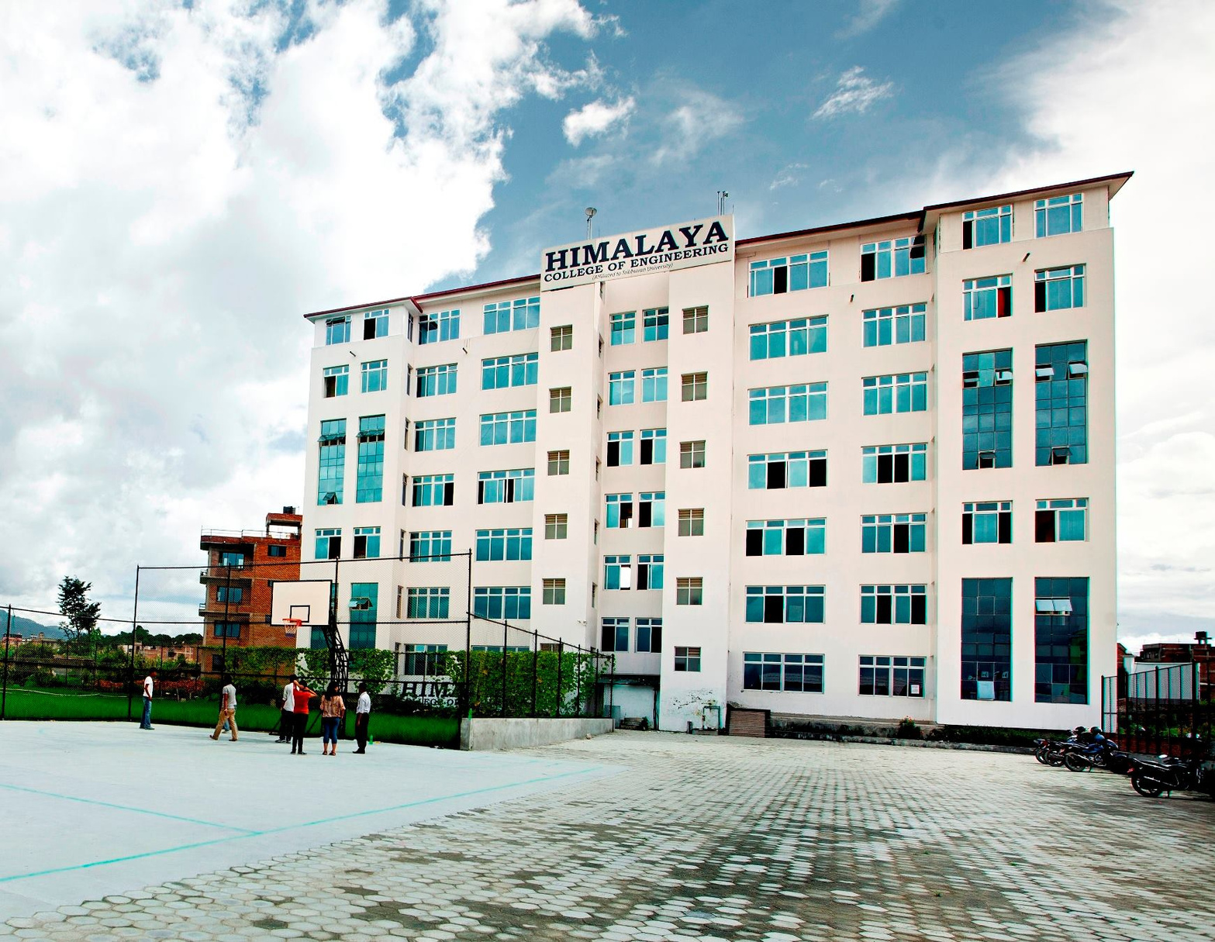
4.HIMALAYA COLLEGE OF ENGINEERING

Slide 44
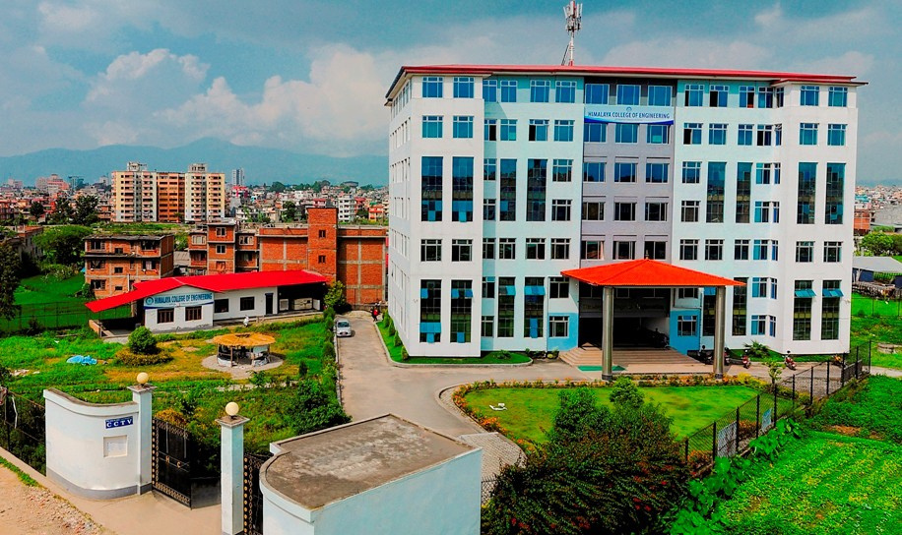
PROGRAMS OFFERED & NUMBER OF SEATS

Slide 45


BE in
Civil Engineering
(96)
BE in
Computer Engineering (48)

Slide 46


BE in
Electronics, Communication & Information Engineering
(48)
Bachelor
in Architecture
(48)

Slide 47
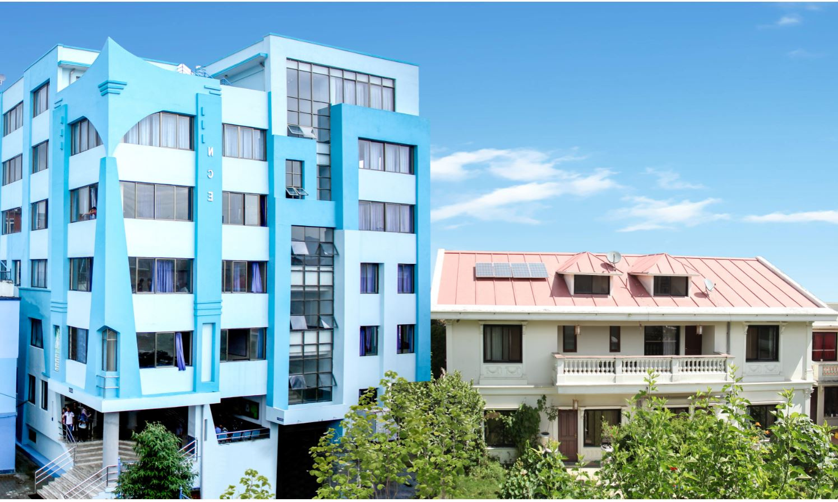
5.NATIONAL COLLEGE OF ENGINEERING

Slide 48
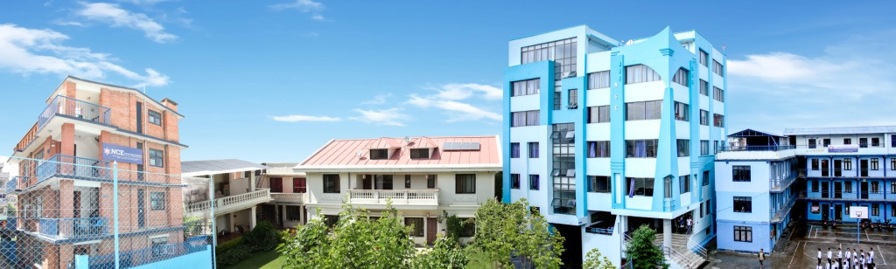
PROGRAMS OFFERED & NUMBER OF SEATS

Slide 49


BE in
Civil Engineering
(96)
BE in
Computer Engineering (48)

Slide 50


BE in
Electronics, Communication & Information Engineering
(48)
BE in
Electrical Engineering (48)

Slide 51
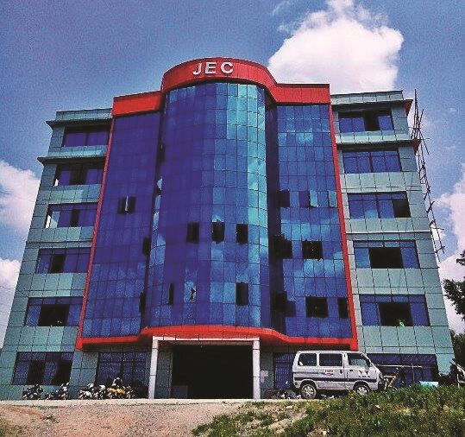
6.JANAKPUR ENGINEERING COLLEGE

Slide 52

PROGRAMS OFFERED & NUMBER OF SEATS

Slide 53



BE in
Electronics, Communication & Information Engineering
(48)
BE in
Civil Engineering
(96)
BE in
Computer Engineering (48)

Slide 54
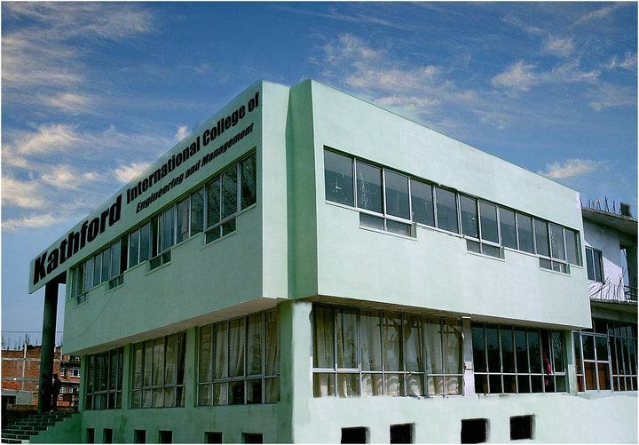
7.KATHFORD INTERNATIONAL COLLEGE

Slide 55

PROGRAMS OFFERED & NUMBER OF SEATS

Slide 56



BE in
Electronics, Communication & Information Engineering
(48)
BE in
Civil Engineering
(96)
BE in
Computer Engineering (48)

Slide 57
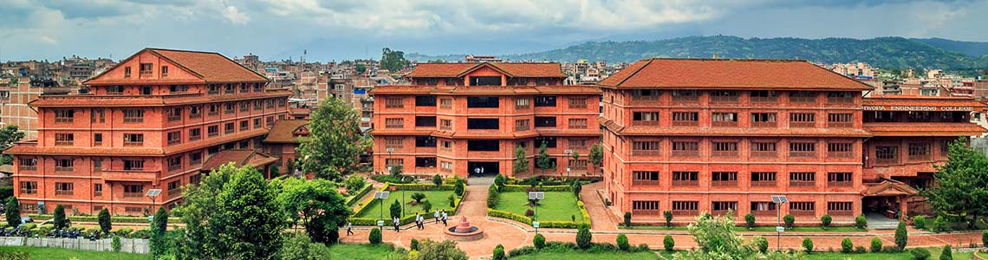
8.KHWOPA COLLEGE OF ENGINEERING

Slide 58
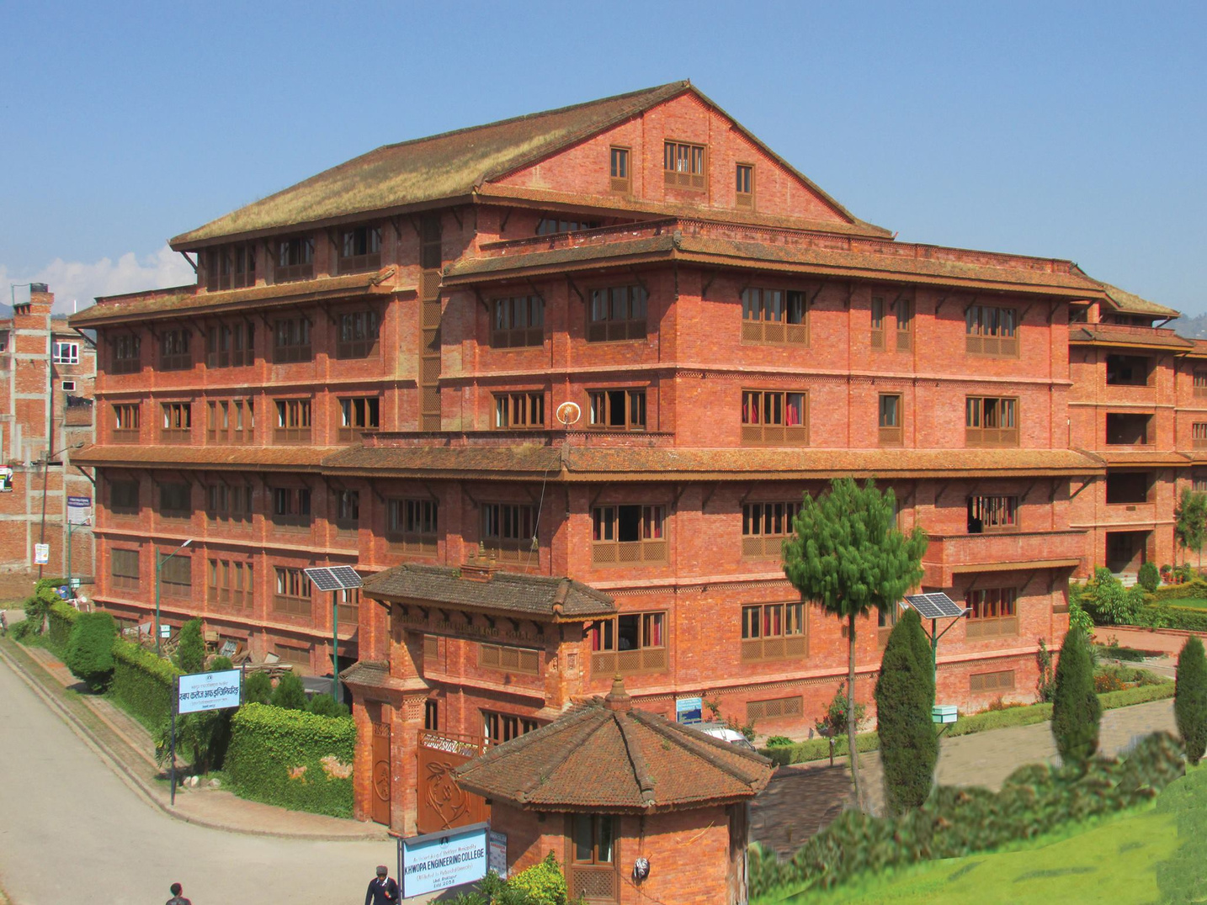
PROGRAMS OFFERED & NUMBER OF SEATS

Slide 59



BE in
Electronics, Communication & Information Engineering
(48)
BE in
Civil Engineering
(96)
BE in
Computer Engineering (48)

Slide 60
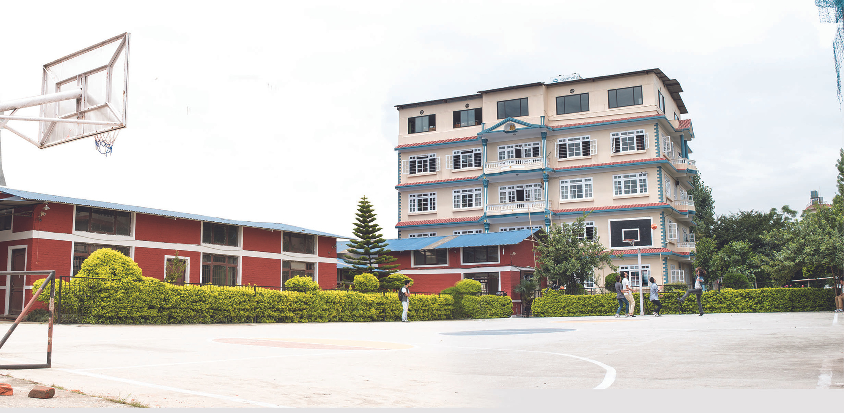
9.SAGARMATHA ENGINEERING COLLEGE

Slide 61
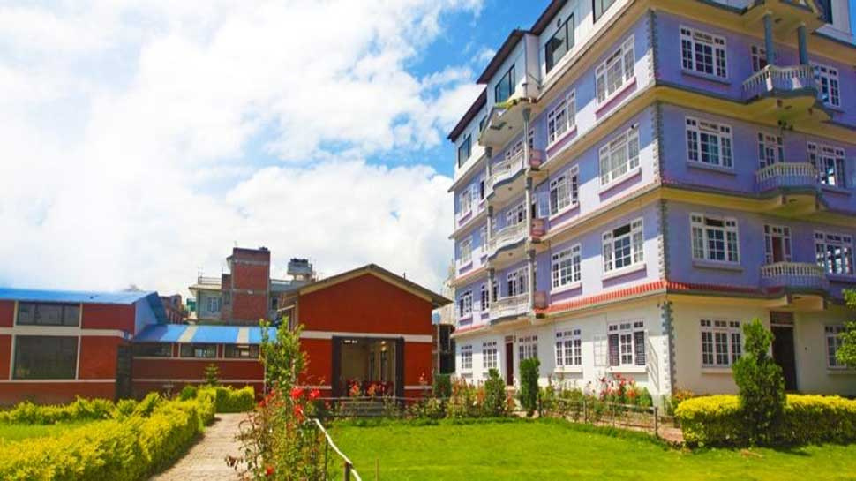
PROGRAMS OFFERED & NUMBER OF SEATS

Slide 62



BE in
Electronics, Communication & Information Engineering
(48)
BE in
Civil Engineering
(48)
BE in
Computer Engineering (48)

Slide 63
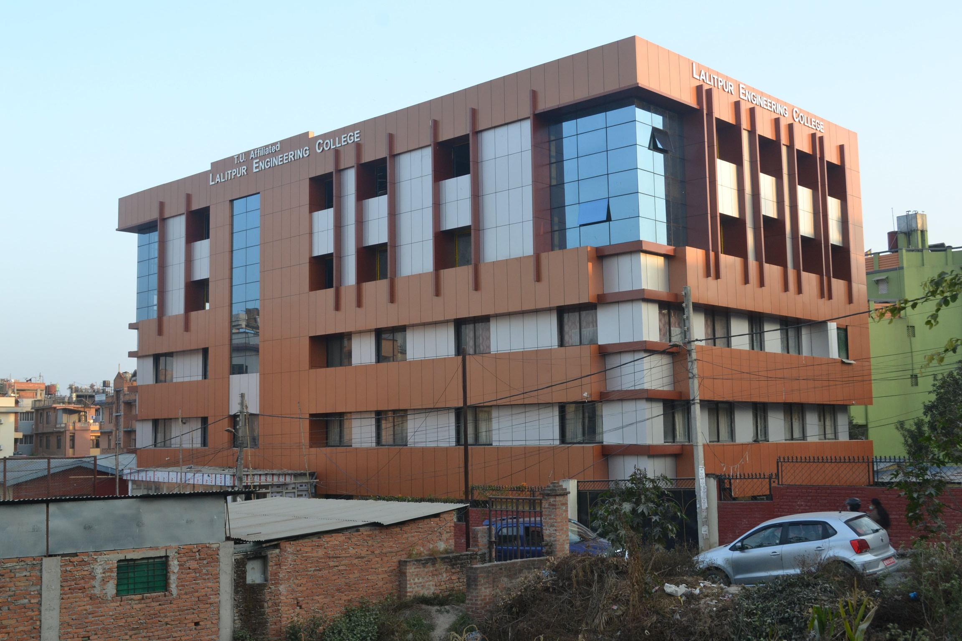
10.LALITPUR ENGINEEERING COLLEGE

Slide 64
PROGRAMS OFFERED & NUMBER OF SEATS

Slide 65


BE in
Civil Engineering
(48)
BE in
Computer Engineering (48)

Slide 66
"Success is not the key to happiness. Happiness is the key to success. If you love what you are doing, you will be successful." – Albert Schweitzer

Slide 67


